Slide 1
The toString() Method

Slide 2
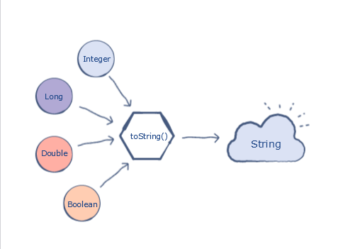
What is toString()?
A toString() is an in-built method in Java that returns the value given to it in string format.
Hence, any object that this method is applied on, will then be returned as a string object.

Slide 3
How to use it
The toString() method in Java has two implementations;
The first implementation is when it is called as a method of an object instance:
class HelloWorld {
public static void main( String args[] ) {
//Creating an integer of value 10
Integer number=10;
// Calling the toString() method as a function of the Integer variable
System.out.println( number.toString() );
}
}

Slide 4
The Second Implementation
The second implementation is when you call the member method of the relevant class by passing the value as an argument.
class HelloWorld {
public static void main( String args[] ) {
// The method is called on datatype Double
// It is passed the double value as an argument
System.out.println(Double.toString(11.0));
// Implementing this on other datatypes
//Integer
System.out.println(Integer.toString(12));
// Long
System.out.println(Long.toString(123213123));
}
}

Slide 5
toString and objects in print or println
Consider that a class has overridden the toString() method to display its parameters.
If you pass the object name into a print or println statement, the class toString() method will be printed.
Otherwise, calling toString() on an object returns its hash code:
Sample Output: java.lang.Object@7a81197d

